Slide 1
Modern Control Theory
Model Predict Control - MPC – Lecture 9
Unconstrained Control move calculation - MIMO

Slide 2
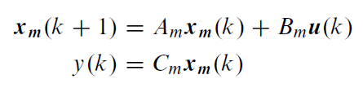

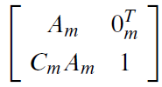
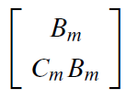

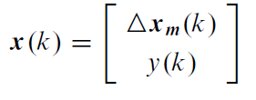
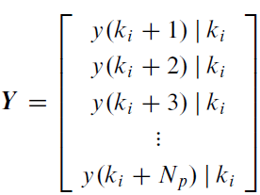
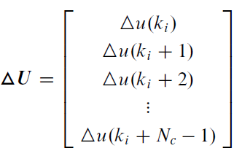
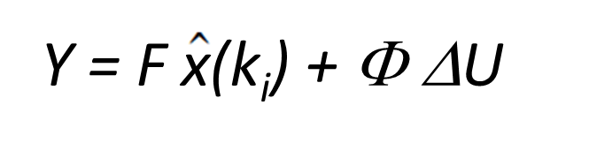
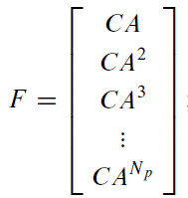
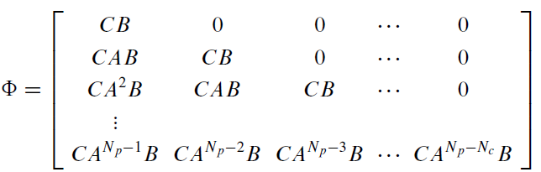
Prediction using State space models (6/6)
System
representation
System in incremental form
y(k+1) = C x(k)
A =
B =
C =
Output Prediction equation
Np x 1
Np x Nc

Slide 3



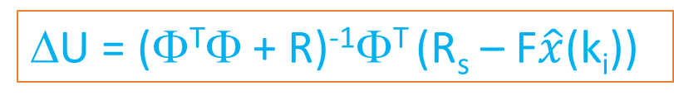
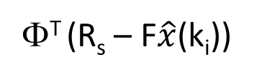
Unconstrained solution – SISO (2/2)
Now
=
^
+
= 0
(Φ^{T}Φ+ R)ΔU =
Φ^{T} (R_{s} – F$\hat{x}$(k_{i}))
Solving for ΔU we get
Implementation steps ONLINE
Obtain the current measurements of states,
Estimate the states using Kalman filter
Compute the optimal finite horizon control sequence (u_{k}, u_{k+1}, …u_{M})
Implement first move u_{k}
Repeat from Step 1
ΔU = (Φ^{T}Φ + R)⁻¹Φ^{T} (R_{s} – F$\hat{x}$(k_{i}))
u_{ki} = u _{(ki-1)} + Δu_{ki}
(first value in ΔU)
^

Slide 4
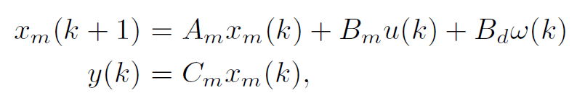

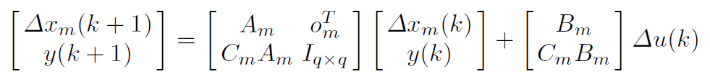
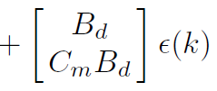




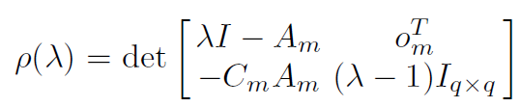

Prediction using State space models - MIMO
m inputs, q outputs and n1 states
For good control q <=m
w(k) is integrated white noise
Am is n1 x n1
Bm is n1 x m
Bd is n1 x m
Cm is q x n1
u is m x 1
y is q x 1
Incremental form
Augmented
‘q’ Integrators

Slide 5
Prediction using State space models - MIMO
System
representation
System in incremental form
y(k+1) = C x(k)
Output Prediction equation
q*NpX 1
Output Prediction equation
m*Nc X 1
(q*Np x (n1+q)
q*Np x m*Nc

Slide 6
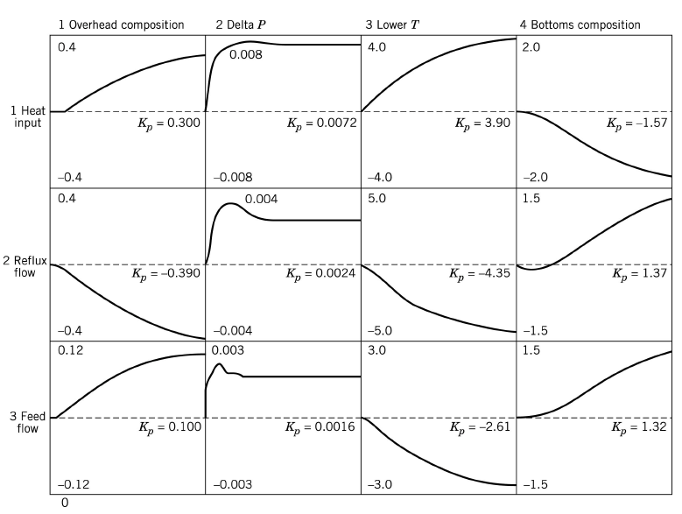
Cost function
Minimize the error between set-point and predicted response at all steps
This leads faster response
Minimize the control that minimized the error between set-point and predicted response at all steps
This leads trade off between faster response and use of input energy/
constraints on rate of change of input
For MIMO system:
Y = step prediction for output (q*Np x 1)
Rs = Set-point trajectory into the future (q*Np x 1)
Δu = Nc future control moves (m*Nc x 1)
R – penalty on control move (m*Nc x m*Nc )

Slide 7

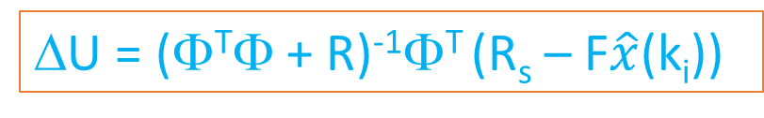
Unconstrained solution – MIMO
Now
=
^
+
= 0
(Φ^{T}Φ+ R)ΔU =
Φ^{T} (R_{s} – F$\hat{x}$(k_{i}))
Solving for ΔU we get
Implementation steps ONLINE
Obtain the current measurements of states,
Estimate the states using Kalman filter
Compute the optimal finite horizon control sequence (u_{k}, u_{k+1}, …u_{M})
Implement first move u_{k} for each of the inputs
Repeat from Step 1
ΔU = (Φ^{T}Φ + R)⁻¹Φ^{T} (R_{s} – F$\hat{x}$(k_{i}))
u_{ki} = u _{(ki-1)} + Δu_{ki}
(first m value in ΔU)

Slide 8
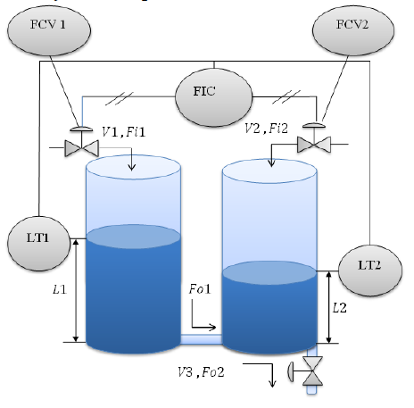






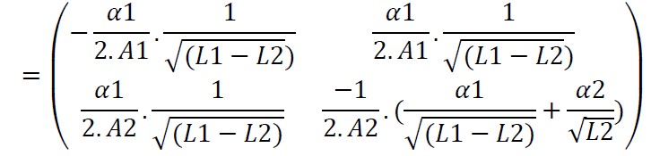

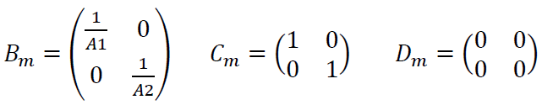
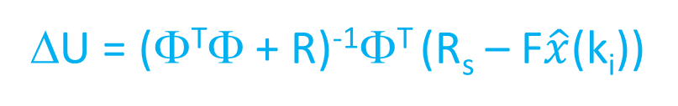
Example problem
Level control of coupled tanks
Linearize around some operating point (h1.h2), we get
A_{m}
Matrices to compute:
Φ, F, Φ^{T}Φ, Φ^{T} R_{s ,} Φ^{T} F
ΔU = (Φ^{T}Φ + R)⁻¹Φ^{T} (R_{s} – F$\hat{x}$(k_{i}))

Slide 9



Demo
Linearize around L1 = 4m, L2 = 3.5m
Sampling time = 0.05 secs, discretize
Np = 10, Nc = 3

